Slide 1

Government of India
HARAGADDE CLUSTER
Bangalore Urban Zilla Panchayath
Anekal Taluk Panchayath - Karnataka
National Level Workshop on experience sharing by elected representatives from SPMRM Clusters
DATE 24th June 2019 at New Delhi

Slide 2
INTRODUCTION TO THE CLUSTER

Slide 3
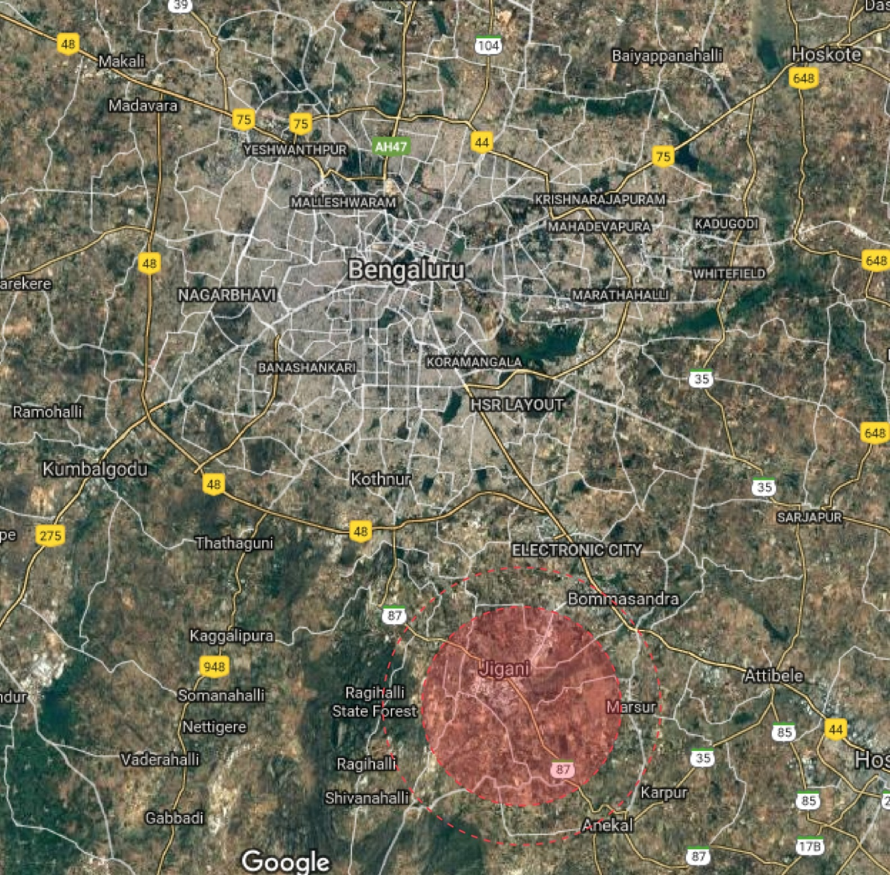
01
REGIONAL CONTEXT
Cluster is located in Anekal Taluk, Bengaluru Urban District.
35 km from Bengaluru city adjoining to the Electronic City. – Industrial Hub

Slide 4
02
CLUSTER PROFILE
General Profiling
Haragadde Cluster
- 14960 HHs
- 75% Decadal GR
- Area 6432.9 Ha
GP1: Haragadde
- 4040 HHs
- 88% Decadal GR
- Area 1328.19 Ha
GP 2: Hennagara
- 4741 HHs
- 87% Decadal GR
- Area 1570.71 Ha
GP 3: Hulimangala
- 4280 HHs
- 72% Decadal GR
- Area 1931.04 Ha
GP 4: Byagadadenahalli
- 1899 HHs
- 41% Decadal GR
- Area 1603.02 Ha

Slide 5
0
Vision
“Haragadde Cluster to be developed into an Agro – Industrial belt, open defecation free with green initiatives, aims to function as E-cluster with linkage to nearby IT-ITES Hub”.

Slide 6
Component wise Financial Details
Sl No | Name of the component | Investment Share (₹ in crores) | Convergence | CGF
1 | Skill Development | 10.06 | 9.56 | 0.50
2 | Agri. Services & Processing | 2.59 | 1.84 | 0.75
3 | 24 x 7 Piped Water Supply | 33.94 | 20.94 | 13.00
4 | Sanitation , Solid & Liquid Waste management | 23.90 | 16.90 | 7.00
5 | Access to Village Street with Drains | 6.30 | 4.36 | 1.94
6 | Inter Village roads Connectivity | 5.42 | 3.80 | 1.62
7 | Health | 1.56 | 1.56 | 0.00
8 | Village Street Light and Sustainable Energy | 1.94 | 0.87 | 1.07
9 | Up gradation of Schools | 10.79 | 7.57 | 3.22
10 | Digital Literacy | 3.71 | 3.31 | 0.40
11 | Administrative Expenditure | 0.50 | 0.00 | 0.50
 | Total | 100.71 | 70.71 | 30.00

Slide 7
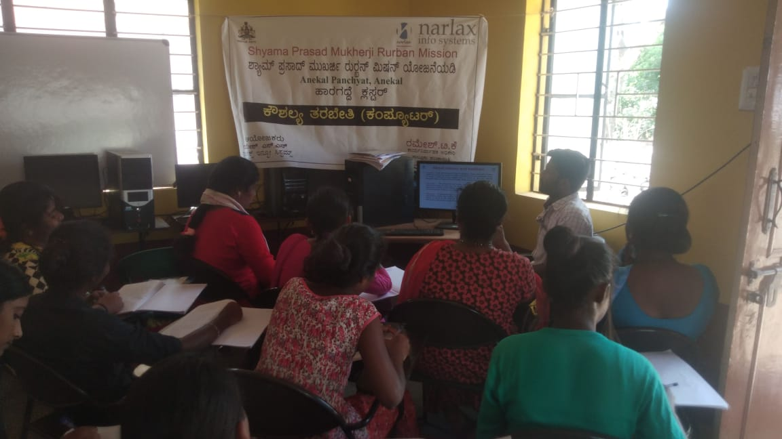
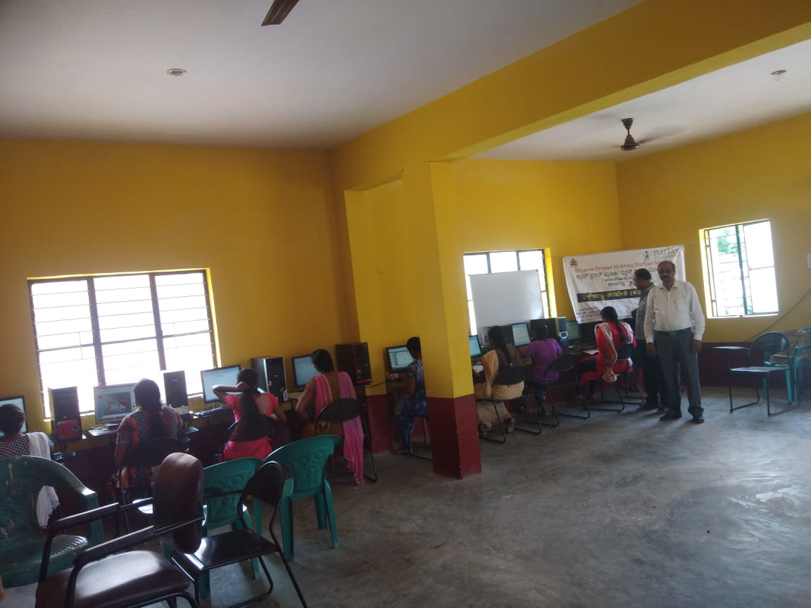
Skill Development-Progress
Total Funds allocated | Convergence | CGF | Expenditure under Convergence | Expenditure under CGF
10.06 | 9.56 | 0.50 | - | 0.18
120 students trained
in ITES services

Slide 8
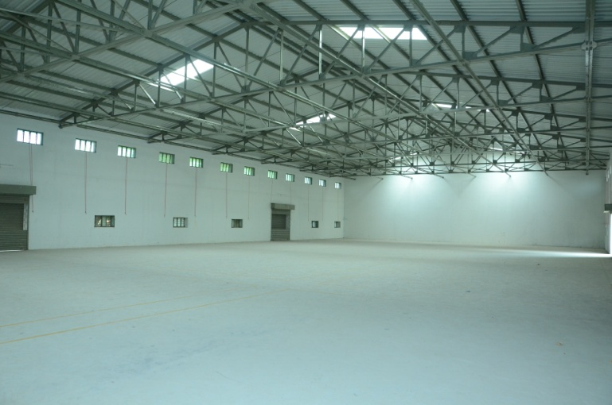
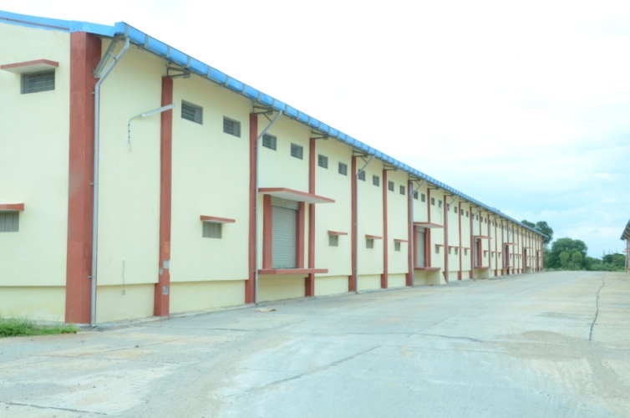
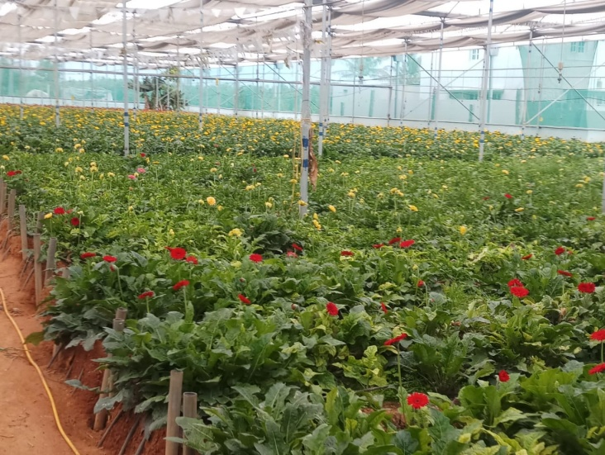
Agri. Services & Processing
Total Funds allocated | Convergence | CGF | Expenditure under Convergence | Expenditure under CGF
2.59 | 1.84 | 0.75 | 11.91 | -
Promotion of Green house facilities
Provision of Cold Storage
Creation of Market linkages for the produce

Slide 9
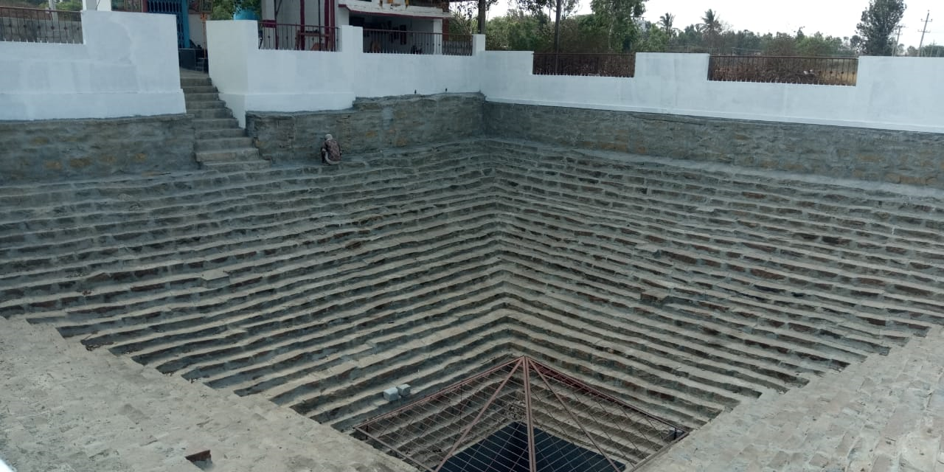
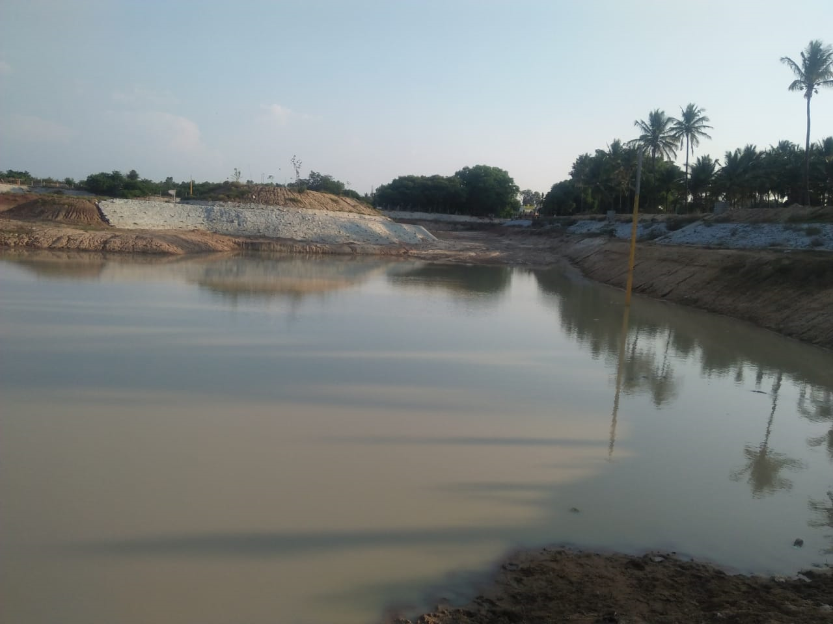
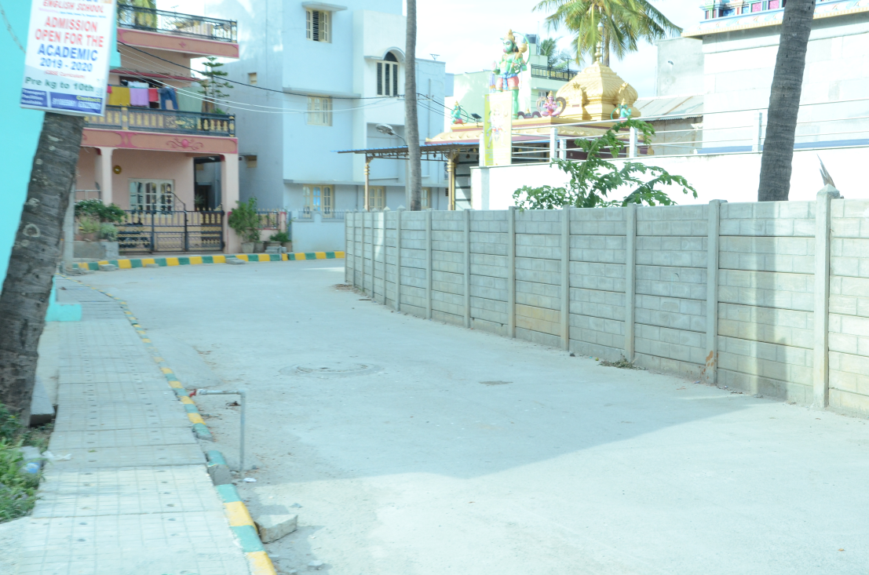
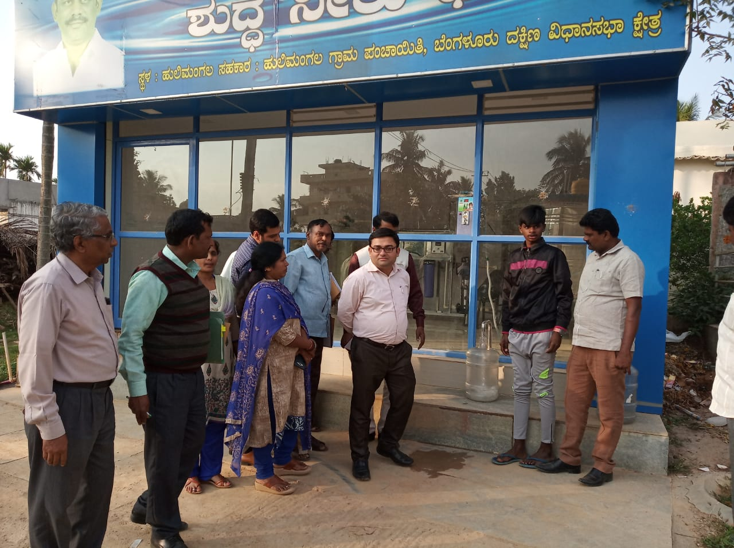
24 x 7 Piped Water Supply
Total Funds allocated | Convergence | CGF | Expenditure under Convergence | Expenditure under CGF
33.94 | 20.94 | 13.00 | 7.21 | -
Construction of Water Storage Tank
Laying of pipelines
Provision of household individual connection
Construction of OHT

Slide 10
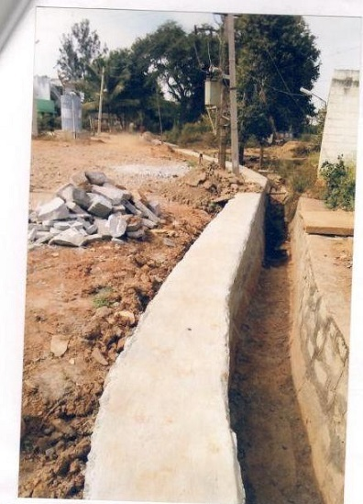
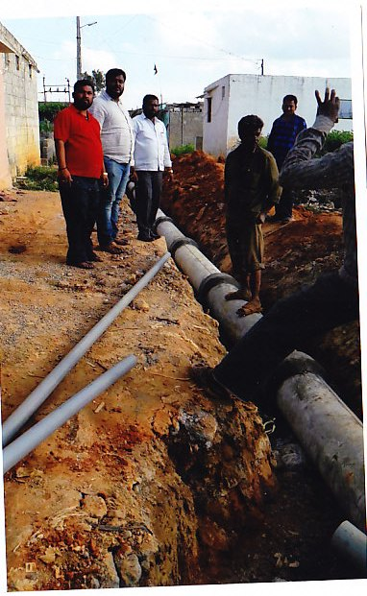
Sanitation Solid & Liquid Waste Management
Total Funds allocated | Convergence | CGF | Expenditure under Convergence | Expenditure under CGF
23.90 | 16.90 | 7.00 | 2.18 | -
All 4 GPs are declared as Open Defecation Free GPs
Construction of Community Toilets
Construction of UGDs in all the villages
Land for Four STPs has been identified and tendering process is on.

Slide 11
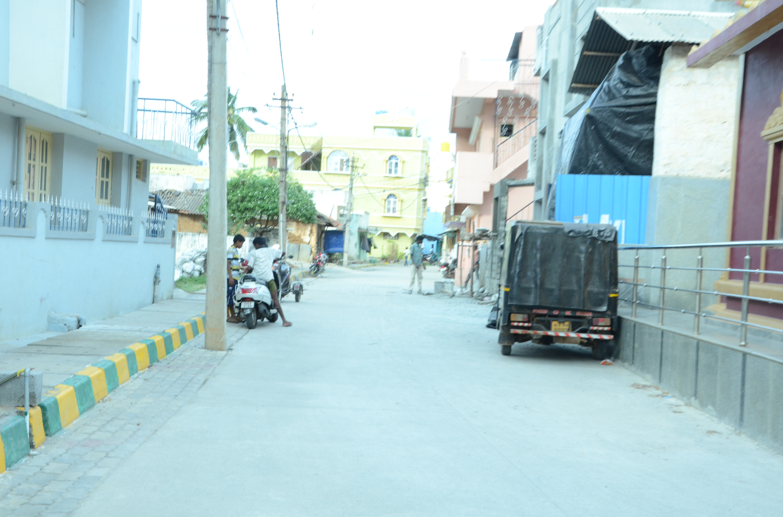
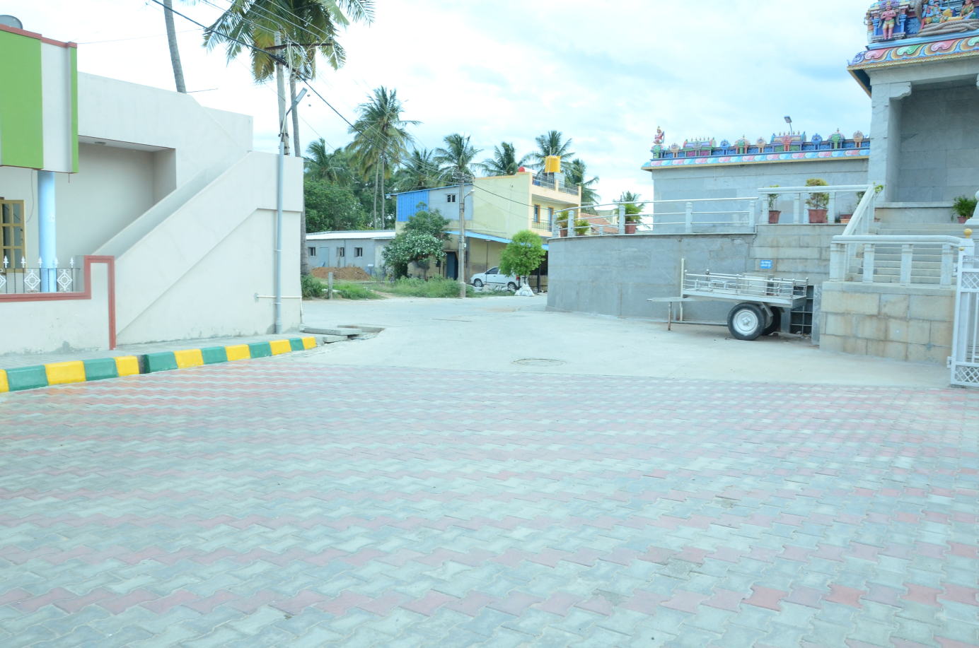
Access to Village Street with Drains
Total Funds allocated | Convergence | CGF | Expenditure under Convergence | Expenditure under CGF
6.30 | 4.36 | 1.94 | 12.54 | -
Construction of New Drains in all GPs
Construction of village connectivity roads

Slide 12
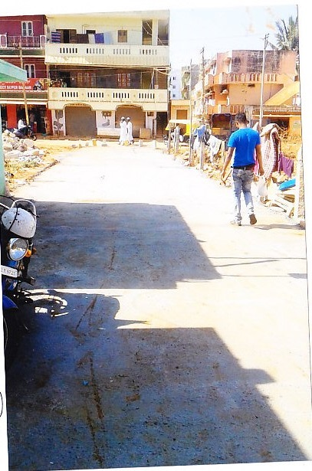
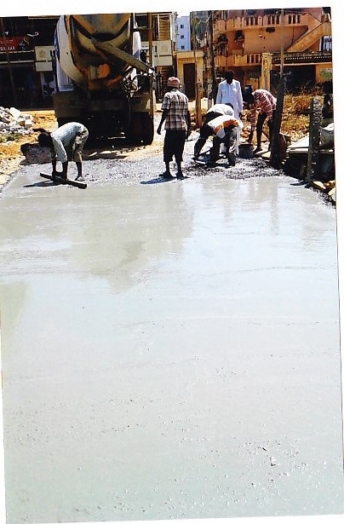
Inter Village roads Connectivity
Total Funds allocated | Convergence | CGF | Expenditure under Convergence | Expenditure under CGF
5.42 | 3.80 | 1.62 | 3.84 | -
Laying of about 29 kms of link roads between villages.
Construction of village connectivity roads

Slide 13
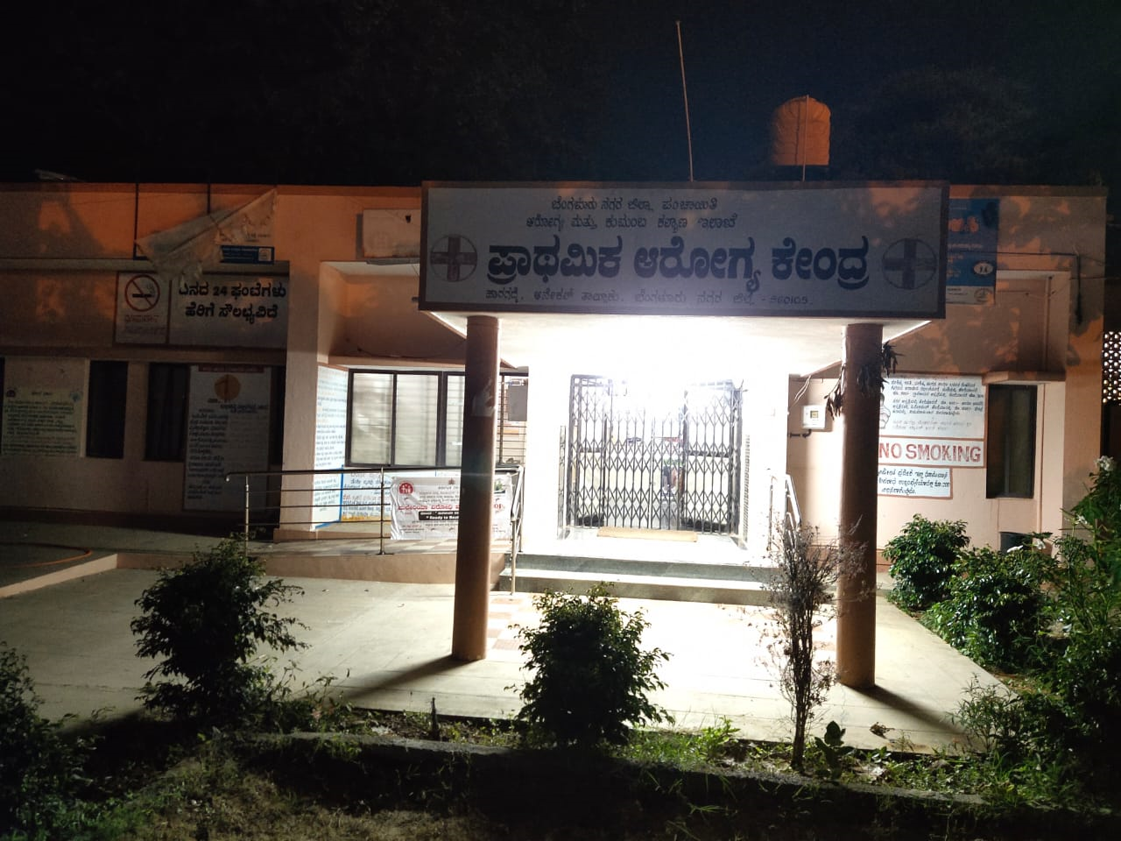
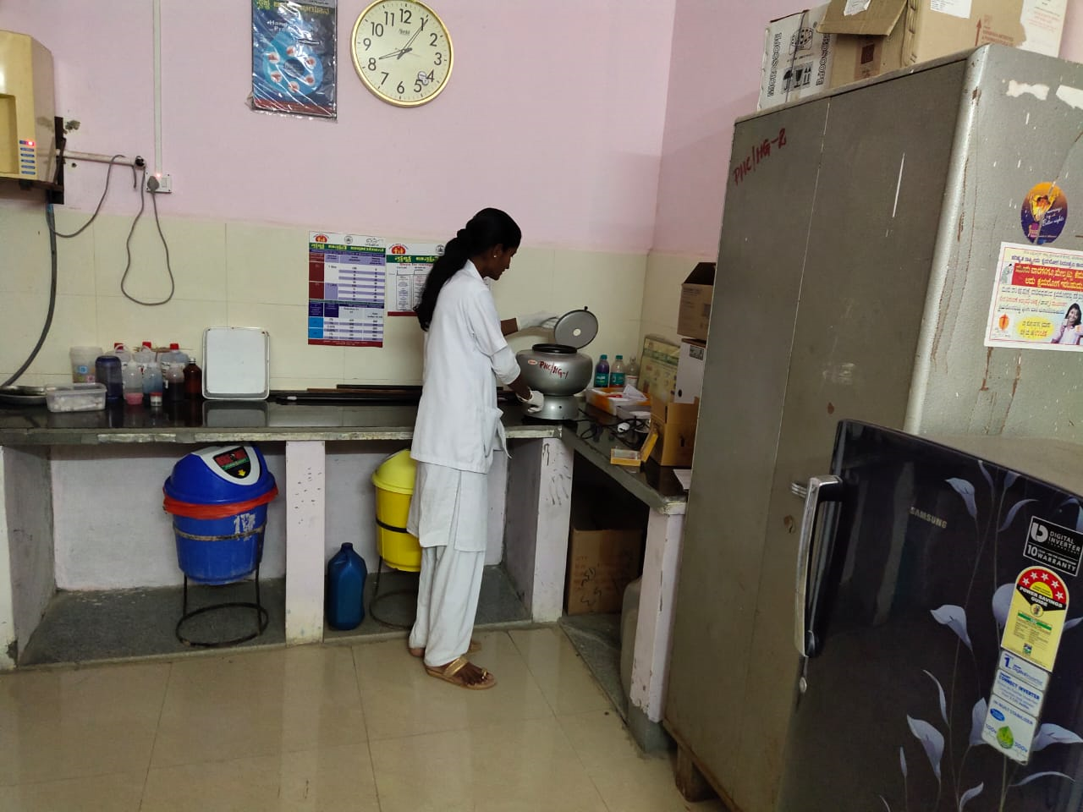
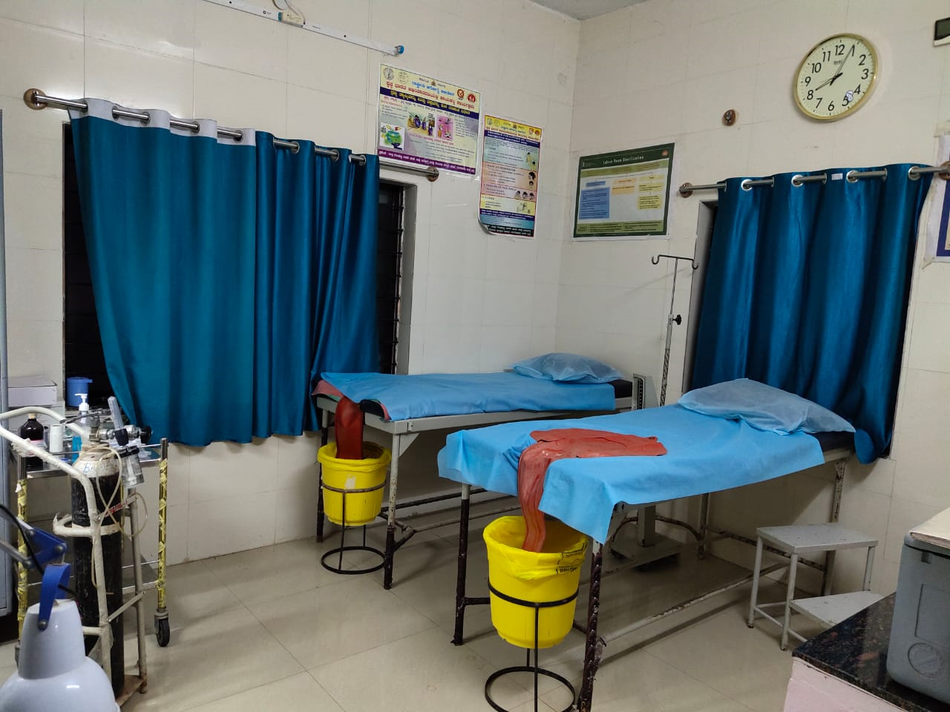
Health
Total Funds allocated | Convergence | CGF | Expenditure under Convergence | Expenditure under CGF
1.56 | 1.56 | - | 0.57 | -
24/7 PHC
Up-gradation of diagnostic lab with CSR support
Providing ambulance services under NHM

Slide 14
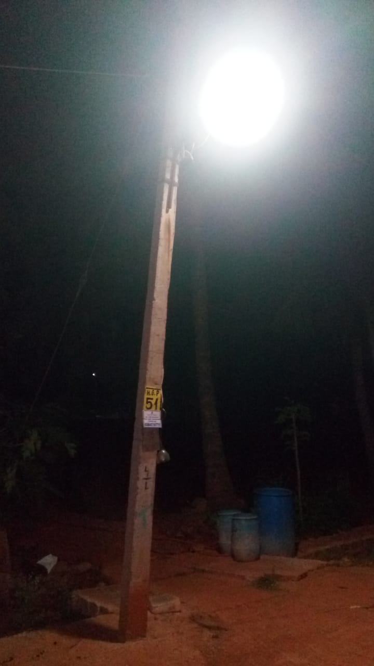
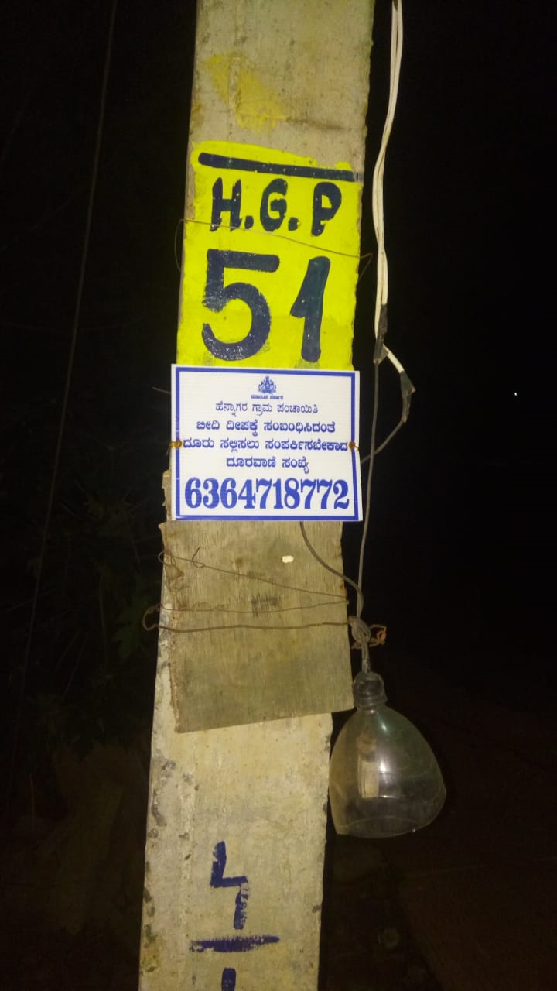
Village Street Light and Sustainable Energy
Total Funds allocated | Convergence | CGF | Expenditure under Convergence | Expenditure under CGF
1.94 | 0.87 | 1.07 | 1.92 | -
Providing LED lighting through out the villages
IVRS help line for registering breakdown
Provision for 4 Roof top Solar generation units at GPs

Slide 15
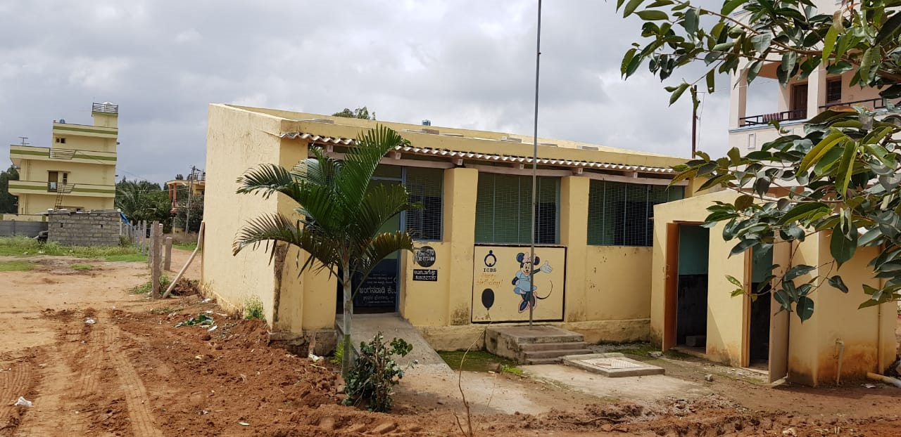
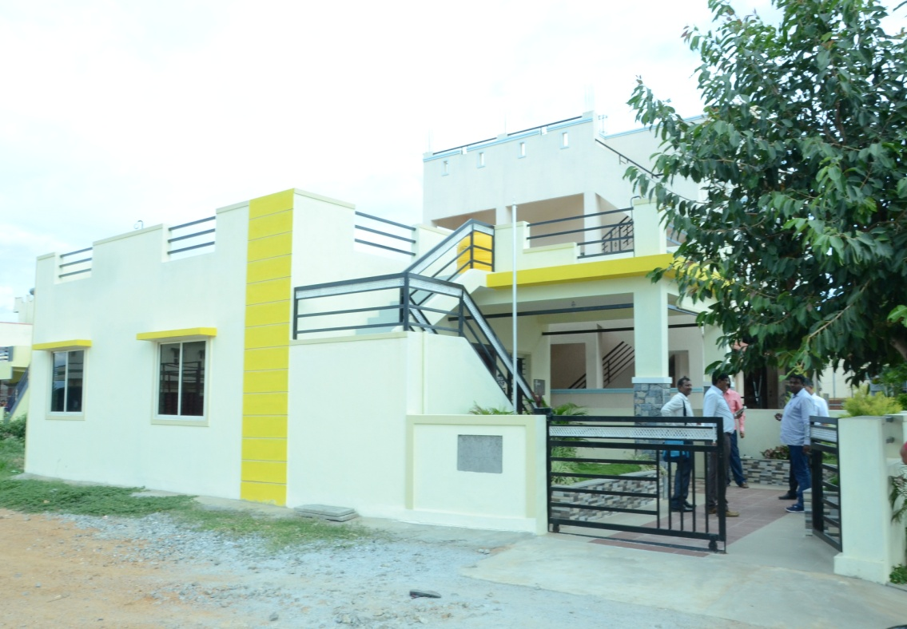
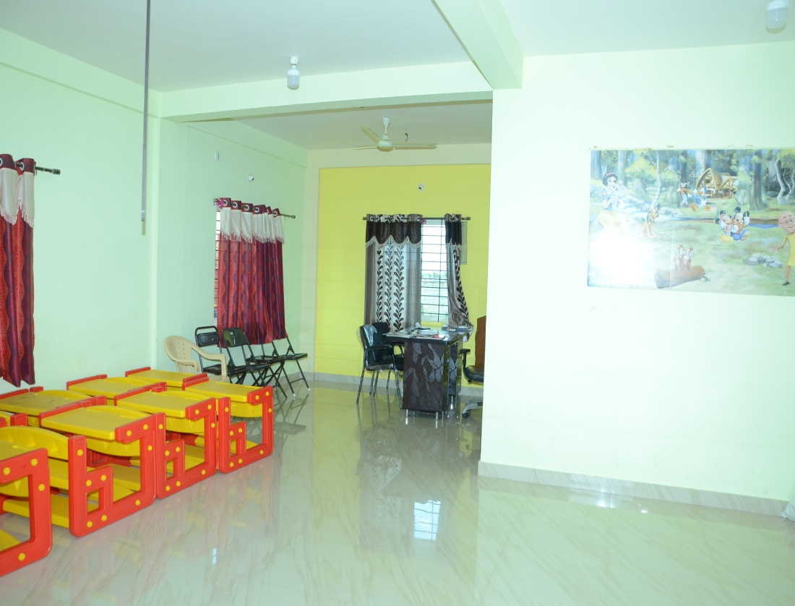
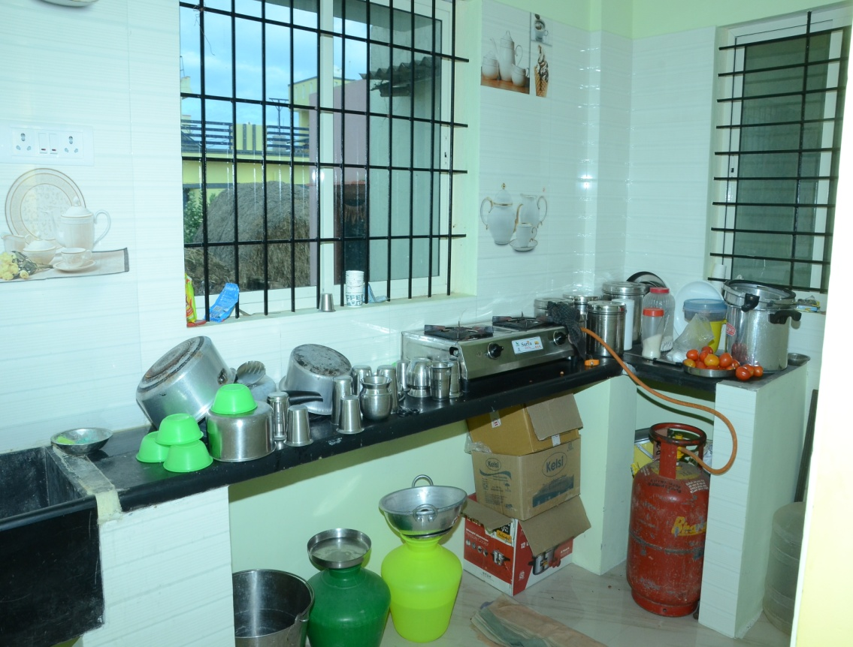
Up gradation of Schools
Total Funds allocated | Convergence | CGF | Expenditure under Convergence | Expenditure under CGF
10.79 | 7.57 | 3.22 | 0.75 | -

Slide 16
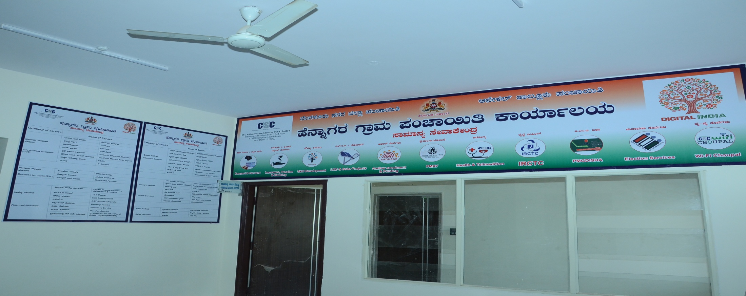
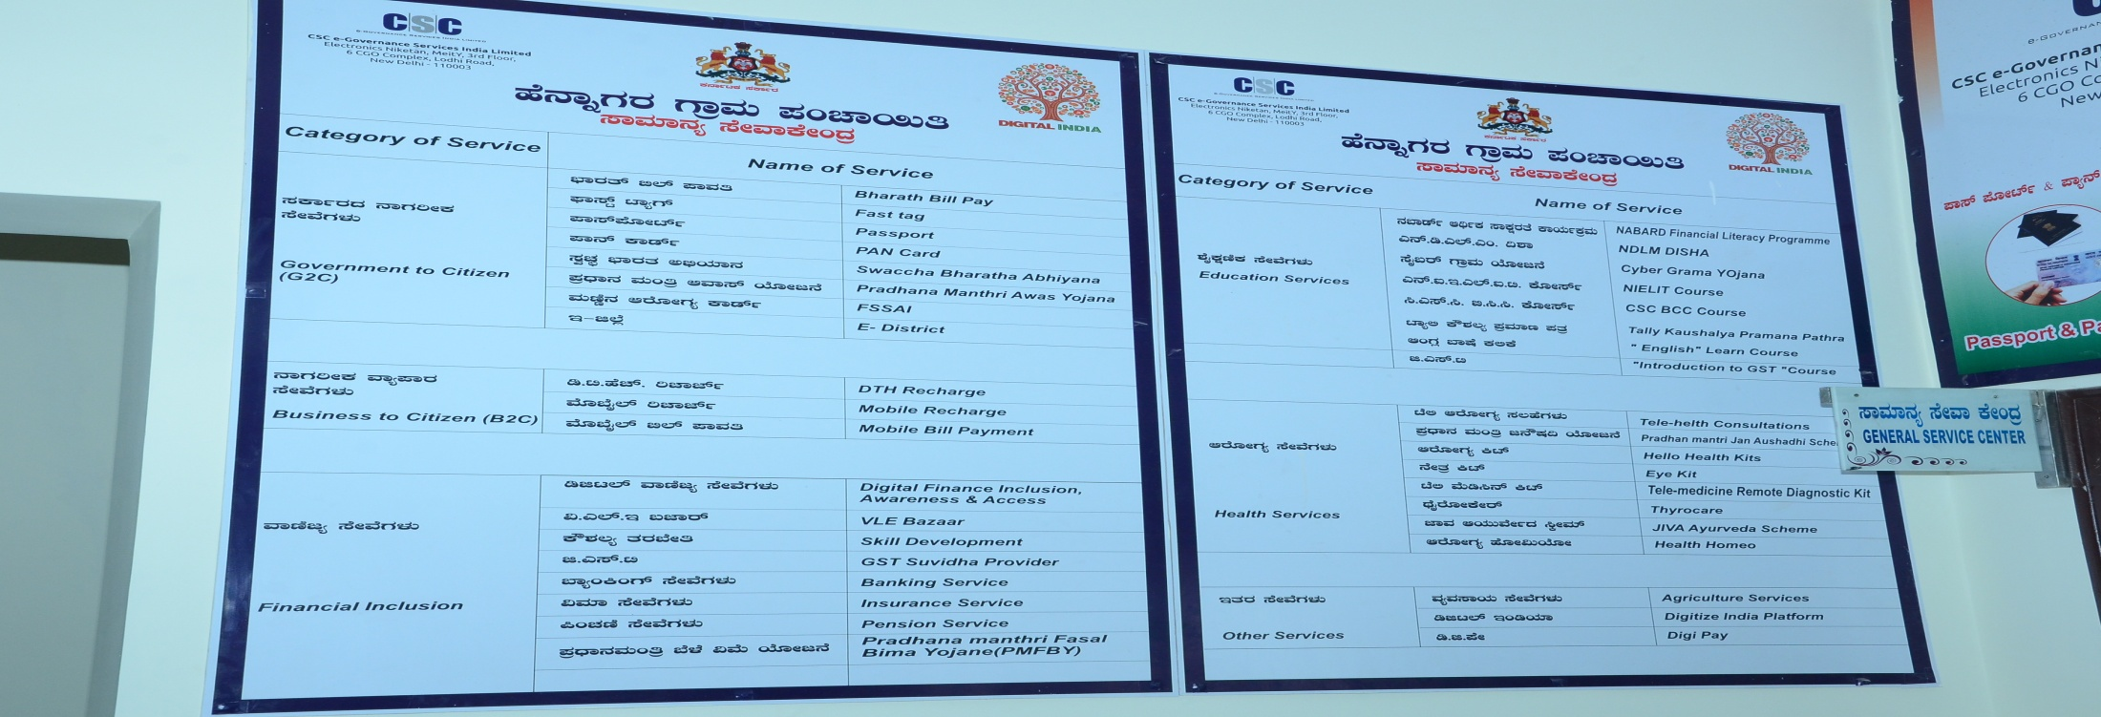
Digital Literacy
Total Funds allocated | Convergence | CGF | Expenditure under Convergence | Expenditure under CGF
3.71 | 3.31 | 0.40 | 0.50 | -
About 100 Common Services under one roof.
One stop facility for payment of amenities
Servicing for RTE, Job Applications for youth etc.,

Slide 17
O&M AGENCIES
Sl. No. | Component | O&M Agencies | WAY Forward
1 | 24x7 Piped Water Supply | Gram panchayat | Ensure revenues from installation of water meters
2 | Sanitation | User/ Citizens | Usage & Sustainability
3 | Solid and liquid waste management | Gram panchayat | IEC/ User fee collection & Sustainability
4 | Access to village street with drains | PRED/GP | Proper maintenance & ensure community awareness on usage
5 | Village streets | Gram panchayat | Proper maintenance & ensure community awareness on usage
6 | Inter village connectivity | PRED | Proper maintenance & ensure community awareness on usage
7 | Up gradation of primary, secondary, higher Education | Education dept., gram panchayat | Proper maintenance & ensure community awareness on usage
8 | Health | KRHDP | Awareness building & Sustainable maintenance
9 | Agriculture | Agriculture dept. | Market Linkage

Slide 18
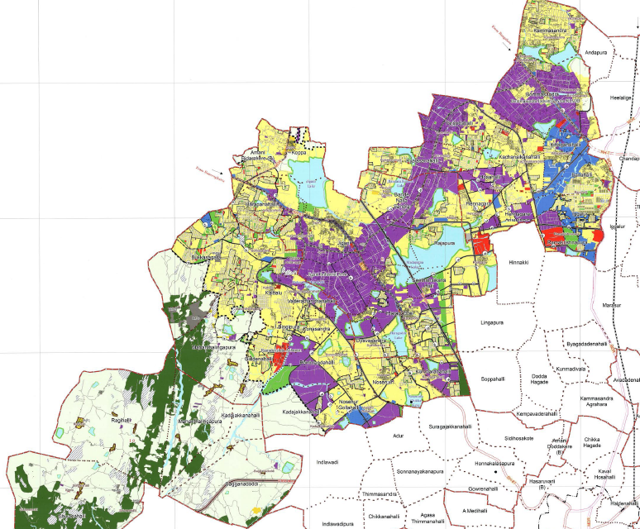
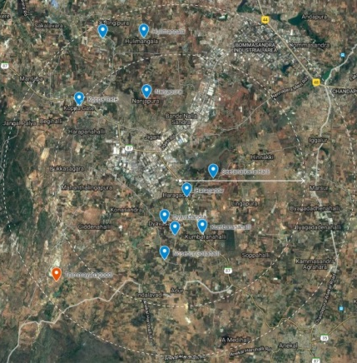
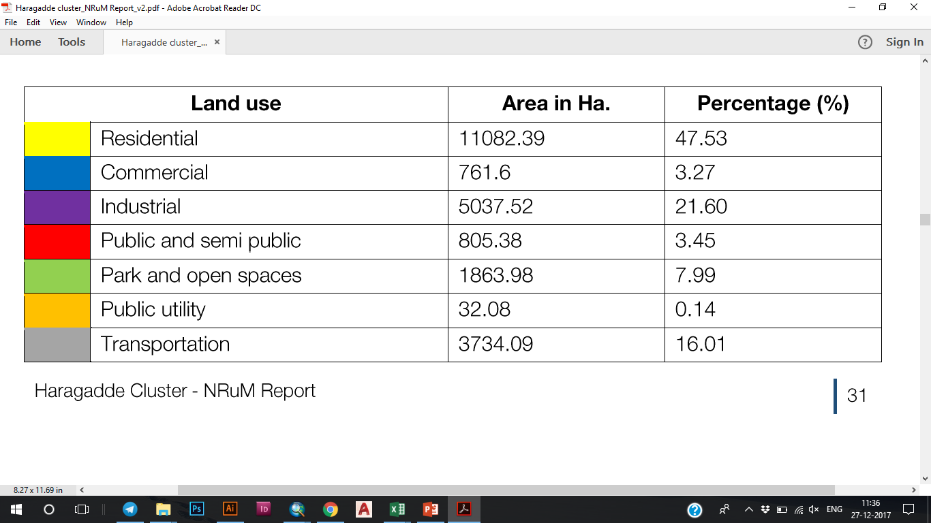
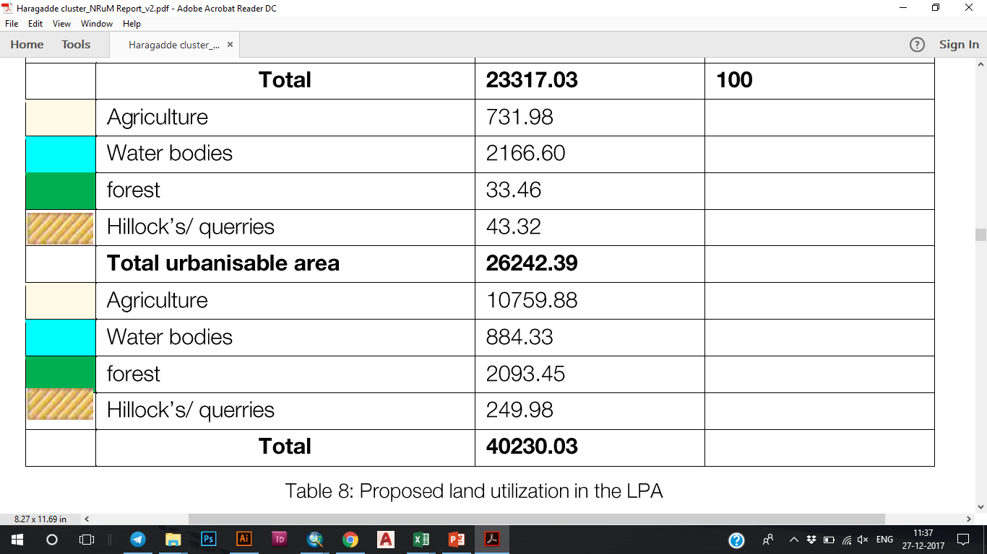
03
LAND USE AND SPATIAL PLANNING
Haragadde Cluster falls with in the Anekal Local Planning Area (A LPA).
Spatial planning will be taken up as per SPMRurban Mission guidelines

Slide 19
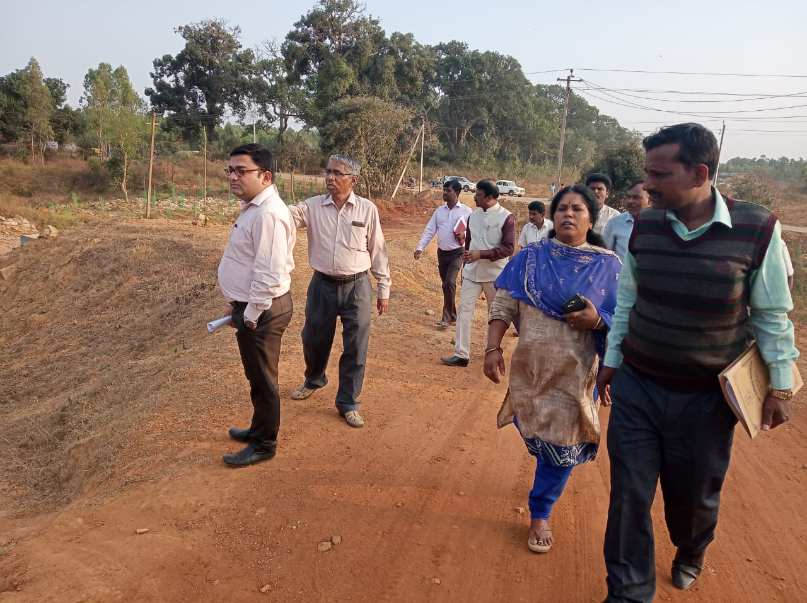
CENTRAL TEAM VISIT TO HULIMANGALA GP
ON 30.01.2019
BENGALURU URBAN ZILLA PANCHAYATH

Slide 20
Thanking You
HARAGADDE CLUSTER
Bangalore Urban Zilla Panchayath
Anekal Taluk Panchayath - Karnataka

